Slide 1
Human Resources Analytics:
A Machine Learning Classification Study
CSC1181 - GROUP II

Slide 2
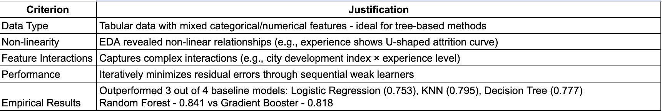
Introduction & Model Selection
Problem Statement:
Binary classification task: Predict probability of job-change intent among data science training candidates
Dataset: 19,158 observations with 25% positive class (seeking job change)
Business objective: Optimize HR resource allocation and reduce training investment waste
Why Gradient Boosting Classifier? We selected the Gradient Boosting model over Random Forest (which had marginally better results) because much of the data was ordinal and explicitly encoded as such, and tree-based methods naturally handle ordinal relationships and non-linear patterns far better than linear models.
Model Architecture:
Ensemble of 224 decision trees (n_estimators)
Maximum depth: 8 (max_depth)
Learning rate: 0.0798 (controls sequential tree contribution)

Slide 3
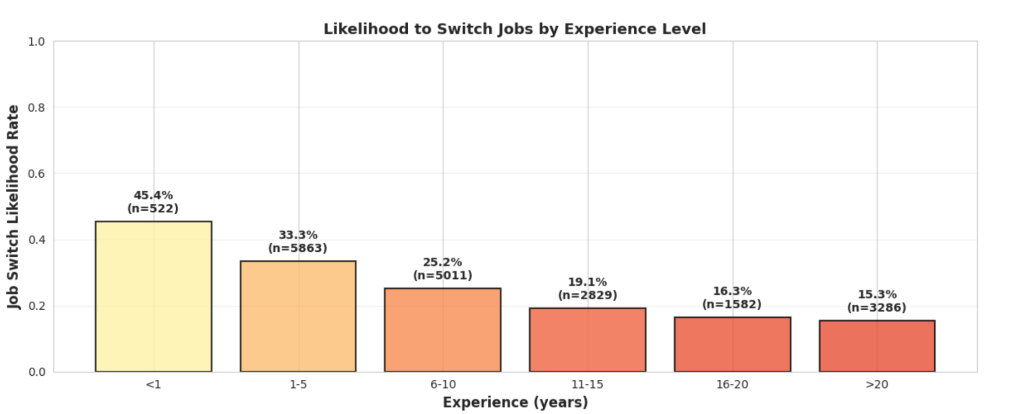
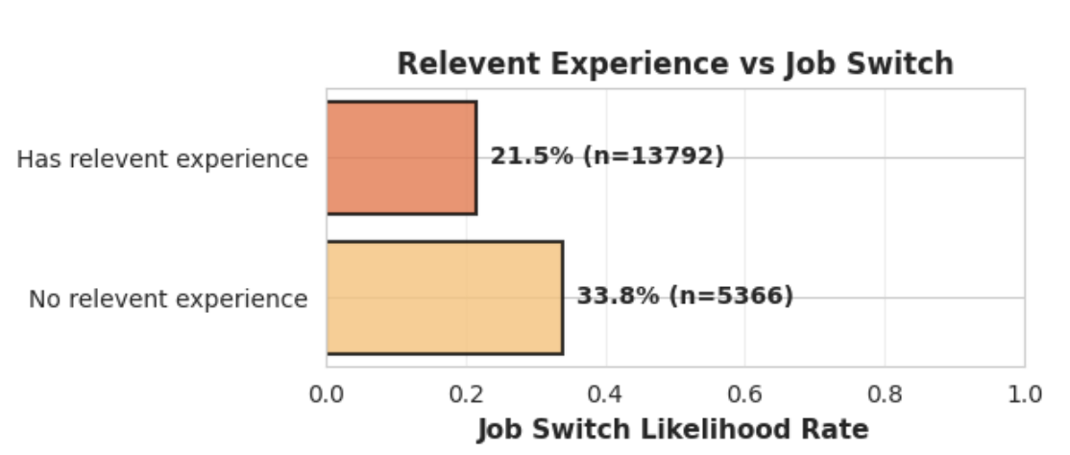
Dataset Characteristics & Preprocessing
Dataset Overview:
n = 19,158 observations, p = 14 features (12 after preprocessing)
Target: 75% class 0 | 25% class 1
Key Features:
Numerical: city_development_index (0.448-0.949), training_hours (1-336)
Ordinal: experience, education_level, company_size, last_new_job
Nominal: gender, major_discipline, company_type, enrolled_university
Missing Data:
gender (23.5%, MNAR)
company_size/type (31-32%, MNAR)
major_discipline(14.7%, MAR / MNAR)
enrolled_university, education_level, experience, last_new_job (<5% each, MNAR)
Preprocessing Pipeline:
MNAR → "Not Provided" category (preserves information)
Removed city (perfect collinearity with city_development_index)
Ordinal encoding for ranked features, one-hot for nominal
Z-score standardization for numerical features

Slide 4
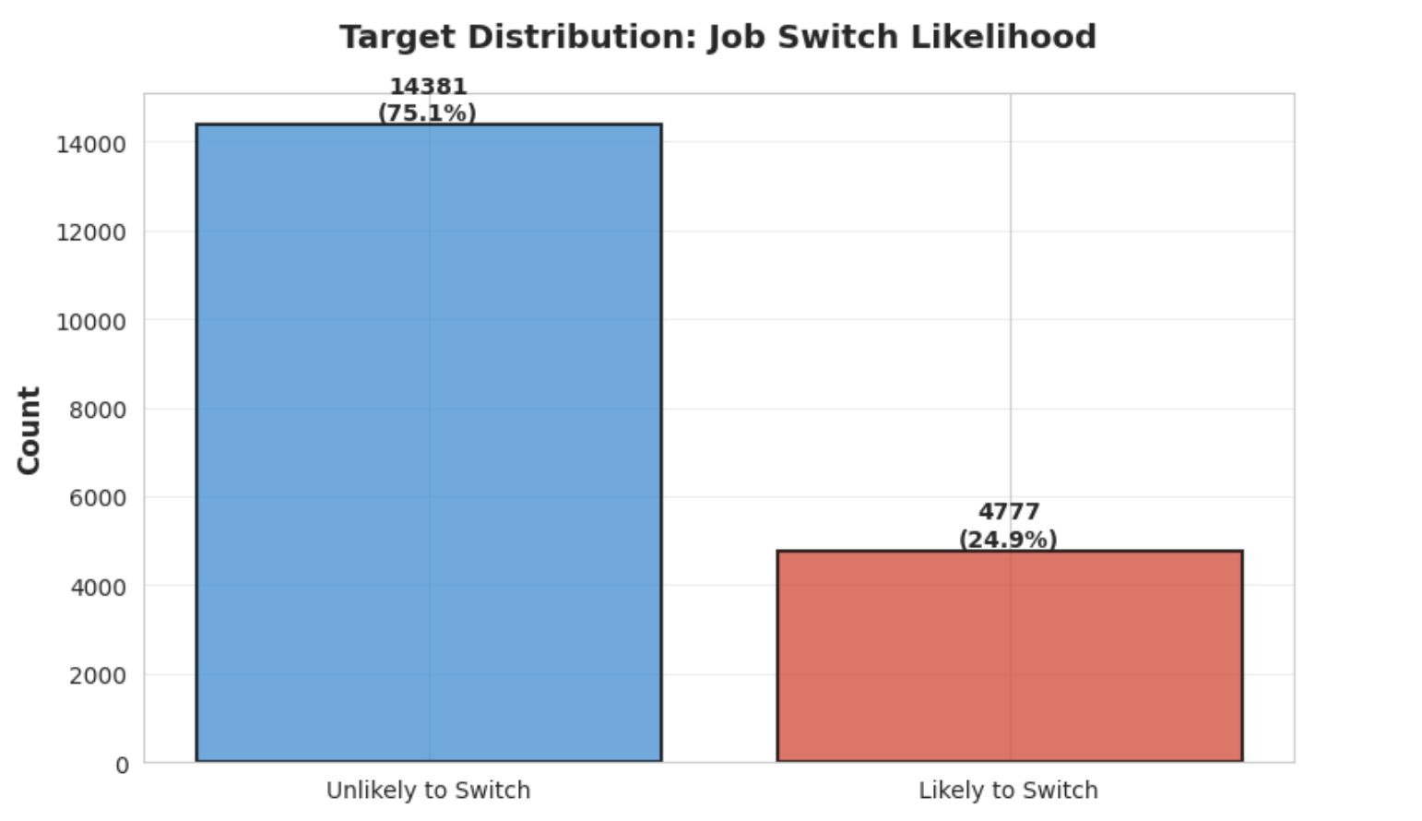
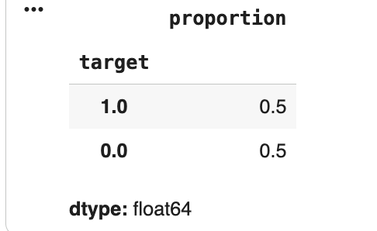
Methodology
Class Imbalance: SMOTE
Problem: 75:25 imbalance → majority class bias
Solution: Synthetic Minority Over-sampling Technique
Generate synthetic samples by interpolating between k=5 nearest neighbors
Result: Balanced 50:50 training distribution
Advantage: Reduces overfitting vs. random oversampling
Model Selection & Optimization
Validation: 70% train | 30% validation (stratified split)
5 Candidate Models: Logistic Regression (0.739), K-Nearest Neighbors (0.777), Decision Tree (0.777), Random Forest (0.842), Gradient Boosting (0.818 → 0.844)
Hyperparameter Tuning:
Method: RandomizedSearchCV (5-fold CV, 20 iterations)
Optimized: n_estimators=224, max_depth=8, learning_rate=0.0798
Notes:
Before beginning any training of any models, it was first necessary to address the problem of the class imbalance as the original dataset
Two options : random oversampling and SMOTE…the latter would replicate rows at random from the minority class while the latter would create synthetic samples by KNN interpolation.
lead to a dataset that is slightly further from the ground truth as it would contain “made up” rows, it does not reduce accuracy but improve it. random oversampling = induces overfitting by allowing the model to constantly see the same rows many times over. Thus we chose SMOTE to balance out our class.
Now, moving onto model selection and optimisation, we created a 70:30 split with the latter being used to fine-tune the model. We call it validation instead of training because the dataset provided came with its own test set which we used at the end in order to show the functionality of our full ML pipeline.
As for the models, we chose 5 base models, 1 linear, 1 clustering, 1 tree based and 2 tree based ensemble methods. We know from preprocessing pipeline that we used ordinal encoding which is more heavily favoured by tree based models

Slide 5
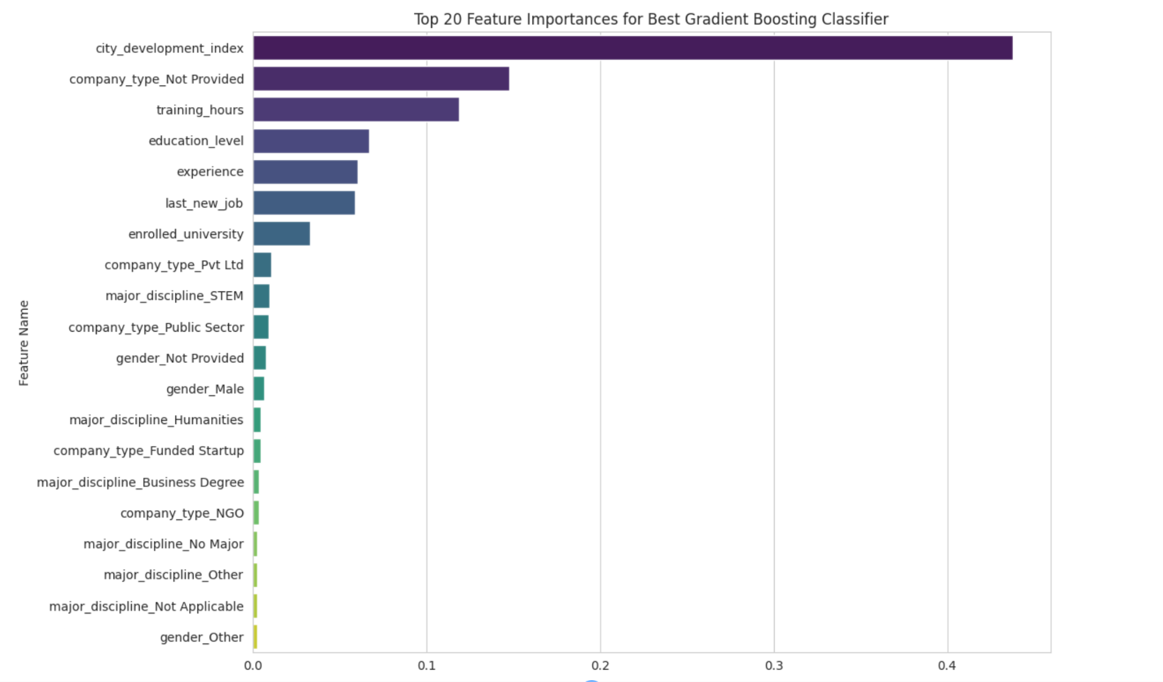
Results & Evaluation
Performance Metrics (Validation Set): Overall: Accuracy = 84.38%, Overall: ROC AUC = 0.845
Confusion Matrix: Type I error = 15%, Type II error = 16%
Top 3 Features (Gradient Boosting Algorithm)
city_development_index: 58-61% attrition in underdeveloped cities vs. 24.6% in well developed cities
company_type (“Not Provided”): Missing employer information signals instability or ambiguity, strongly correlating with higher job switch
training_hours: Negative correlation with attrition
Model Limitations
Gender Bias Detected: Training data: 86.1% male, 8.3% female; Error rates: Male 15.0%, Female 19.8% (+4.8% gap)
SMOTE Limitations: Synthetic samples may not capture true minority class distribution; potential overfitting to interpolated patterns rather than actual data.
Temporal Validity: No time-based validation - model may not generalize to future cohorts

Slide 6
Team Contributions
Group II Members:
Angelo Miculescu
Nikhil Verma
Stanley Masaku
Yuvashree Ponnurangan
Equal Contribution Across All Phases:
Exploratory Data Analysis: Collaborative investigation of data relationships and patterns
Data Preprocessing: Joint brainstorming and decision-making on missing data imputation strategies
Model Development: Shared responsibilities in model selection, training, and hyperparameter tuning
Implementation: Collective coding efforts across preprocessing, modeling, and evaluation pipelines
Documentation: Team-based report writing with distributed section authorship
Repository: gitlab.computing.dcu.ie/angelo.miculescu2/csc1181-group-project

Slide 7
Thank you!

